Slide 1

PSYC100 GENERAL PSYCHOLOGY
PSYCHOPATHOLOGY

Slide 2
Lecture outline
What is abnormality?
The classification of mental disorders
Anxiety disorders
Obsessive-compulsive and related disorders
Depressive and bipolar disorders
Schizophrenia spectrum
Personality disorders

Slide 3
What is abnormality?
Abnormality as deviation from the (statistical) average
  Gifted are statistically rare, is that abnormal?
  Common things like anxiety are considered as disorders.
Abnormality as deviation from the norm
  Society’s norms; is rule breaking is bad, then is having panic attack also bad?
Abnormality as deviation from ideal mental health
  Varies across cultures

Slide 4
What is abnormality?
Abnormality as personal distress
  Obsessive-compulsive behaviour
Abnormality as others’ stress
  Interpersonal aspect; narcissistic personality disorder
Abnormality as maladaptiveness
  Substance use
Abnormality as unexpected behaviour
  Anxiety in anxiety disorders is out of proportion

Slide 5
The classification of mental disorders
Kraepelin published the first recognised textbook of psychiatry in 1883. Kraepelin claimed that certain groups of symptoms occur together sufficiently often for them to be called a ‘disease’ or syndrome.
His classification formed the basis for the Diagnostic and Statistical Manual of Mental Disorders (DSM) and the International Classification of Diseases (ICD).

Slide 6
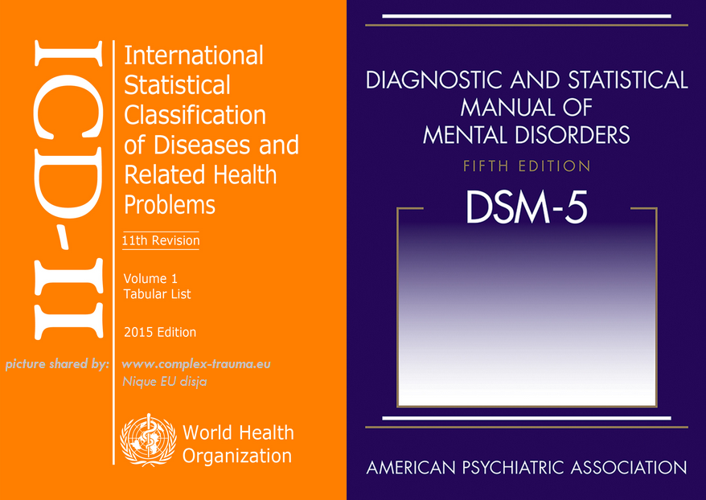
DSM and
ICD

Slide 7
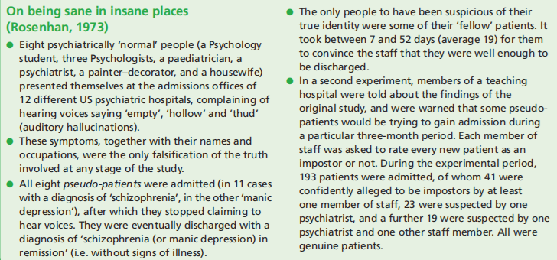
Does classification always work?

Slide 8
DSM 5
I. Neurodevelopmental Disorders (e.g. ADHD, autism)
II. Schizophrenia Spectrum and Other Psychotic Disorders
III. Bipolar and Related Disorders
IV. Depressive Disorders
V. Anxiety Disorders
VI. Obsessive-Compulsive and Related Disorders
VII. Trauma- and Stressor-Related Disorders
VIII. Dissociative Disorders

Slide 9
DSM (cont.)
IX. Somatic Symptom and Related Disorders
X. Feeding and Eating Disorders
XI. Elimination Disorders
XII. Sleep-Wake Disorders
XIII. Sexual Dysfunctions
XIV. Gender Dysphoria
XV. Disruptive, Impulse-Control, and Conduct Disorders
XVI. Substance-Related and Addictive Disorders

Slide 10
DSM (cont.)
XVII. Neurocognitive Disorders
XVIII. Personality Disorders
XIX. Paraphilic Disorders
XX. Other Mental Disorders

Slide 11
Example: Major depressive disorder
A person must experience at least 5 symptoms during the same 2-week period, and the symptoms must represent a change from previous functioning. At least one of the symptoms must be: depressed mood or loss of interest/pleasure.
Depressed mood most of the day, nearly every day
Markedly reduced interest or pleasure in most activities
Significant unintentional weight loss or gain, or change in appetite
Insomnia or hypersomnia
Observable psychomotor agitation or slowing
Fatigue or loss of energy
Feelings of worthlessness or excessive/inappropriate guilt
Reduced ability to think, concentrate, or make decisions
Recurrent thoughts of death, suicidal ideation, or suicide attempt
The symptoms cause clinically significant distress or impairment in social, occupational, or other important areas of functioning.

Slide 12
Anxiety disorders
Separation Anxiety Disorder
Selective Mutism
Specific Phobia
Social Anxiety Disorder (Social Phobia)
Panic Disorder
Agoraphobia
Generalized Anxiety Disorder (GAD)

Slide 13
Separation anxiety disorder
Characterized by excessive fear or distress about being separated from major attachment figures.
Symptoms may include persistent worry about harm happening to them, reluctance to leave home, nightmares about separation, or physical complaints when separation is anticipated.

Slide 14
Selective mutism
Marked by a consistent failure to speak in specific social situations (e.g., school) despite speaking normally in other settings.
Not due to lack of language knowledge, developmental delay, or other communication disorders. Often associated with social anxiety.

Slide 15
Specific phobia
Involves intense fear or anxiety triggered by a specific object or situation (such as claustrophobia, animals, heights, flying, blood/injection/injury, etc.).
Exposure nearly always provokes anxiety, leading to avoidance or enduring with intense distress.
Fear is excessive relative to actual danger.

Slide 16
Social anxiety disorder
A persistent fear of social situations where one may be judged, embarrassed, or scrutinized.
Common triggers include conversations, meeting new people, public speaking, or eating in front of others.
Leads to avoidance or intense distress and interferes with functioning.

Slide 17
Panic disorder
Defined by recurrent, unexpected panic attacks, along with persistent worry about additional attacks or their consequences, and/or significant maladaptive behaviour changes (e.g., avoidance).

Slide 18
Agoraphobia
Fear or anxiety about being in situations where escape might be difficult or help unavailable in case of panic-like symptoms.
Common situations: public transportation, open spaces, enclosed places, crowds, or being outside the home alone.
People may avoid these situations or need a companion.

Slide 19
Generalized anxiety disorder
Chronic, excessive worry about multiple areas of life (work, health, finances, family, etc.) occurring more days than not for at least 6 months.
The person cannot pinpoint the source of anxiety.

Slide 20
Obsessive-compulsive and related disorders
Obsessive-compulsive disorder (OCD)
Body Dysmorphic Disorder
Hoarding Disorder
Trichotillomania (Hair-Pulling Disorder)
Excoriation (Skin-Picking) Disorder

Slide 21
Obsessive-compulsive disorder
A condition involving obsessions, compulsions, or both.
Obsessions: intrusive, unwanted thoughts, urges, or images that cause anxiety.
Compulsions: repetitive behaviours or mental acts performed to neutralize the anxiety or prevent a feared event.
Symptoms are time-consuming or impair functioning.
The person recognizes the thoughts/behaviours as excessive, though insight can vary.
E.g. cleaning, checking, symmetry etc.

Slide 22
Body dysmorphic disorder
Characterized by a preoccupation with perceived defects or flaws in physical appearance that are minor or not observable to others.
Individuals engage in repetitive behaviours (e.g., mirror checking, excessive grooming, skin picking) or mental acts (comparing appearance to others).
Causes significant distress or impairment; may involve muscle dysmorphia.

Slide 23
Hoarding disorder
Marked by persistent difficulty discarding or parting with possessions, regardless of actual value.
This leads to accumulation of clutter that congests living areas and compromises use of space.
Attempts to discard items cause significant distress.
Not explained by lack of space or poverty.

Slide 24
Trichotillomania (Hair-Pulling Disorder)
Recurrent pulling out of one’s hair, leading to noticeable hair loss.
Individuals have repeated attempts to decrease or stop the behaviour.
Often linked to tension before pulling and relief afterward, though this pattern can vary.

Slide 25
Excoriation (Skin-Picking) Disorder
Recurrent skin picking that results in skin lesions.
Repeated efforts are made to reduce or stop picking.
Leads to distress, medical complications, or impairment in social or occupational functioning.

Slide 26
Depressive and Bipolar disorders
Major Depressive Disorder
Persistent Depressive Disorder
Bipolar I
Bipolar II

Slide 27
Major Depressive Disorder
A condition marked by persistent depressed mood or loss of interest, along with other symptoms such as changes in sleep, appetite, energy, concentration, or thoughts of self-harm.
Symptoms last at least 2 weeks and cause significant distress or impairment.

Slide 28
Persistent Depressive Disorder
A chronic, long-lasting form of depression with a low mood that persists for 2 years or more (1 year in children/adolescents).
Symptoms are less severe than MDD but more enduring, often with low energy, poor self-esteem, and hopelessness.

Slide 29
Bipolar I
Defined by at least one manic episode, which is a period of abnormally elevated, expansive, or irritable mood with increased energy and impaired functioning.
Depressive episodes often occur but are not required for diagnosis.
Causes marked impairment, may include psychosis, or require hospitalization.

Slide 30
Bipolar II
Characterized by recurring hypomanic episodes (a milder form of mania that does not cause severe impairment) and major depressive episodes.
No history of full manic episodes.
No marked impairment, no psychosis, and no hospitalization due to hypomania.

Slide 31
Schizophrenia spectrum
Schizophrenia
Schizophreniform Disorder
Schizoaffective Disorder
Brief Psychotic Disorder
Delusional Disorder

Slide 32
Schizophrenia
A chronic disorder with persistent psychotic symptoms (delusions, hallucinations, disorganized speech/behaviour, negative symptoms) lasting ≥6 months, with significant decline in functioning.
Symptoms tend to be long-term and disabling without treatment.

Slide 33
Psychotic symptoms in schizophrenia
Delusions: false beliefs that are sustained in the face of evidence that normally would be sufficient to destroy them
Hallucinations: false perceptions that have a compelling sense of reality (mostly auditory)
Disorganized thought and language
  Nonsensical, rhyming patterns i.e. clanging
Affects emotional expression
  Blunt, flat, or inappropriate affect

Slide 34
Delusions
Persecutory delusions: Belief of being harmed, watched, or targeted by others.
Delusions of reference: Belief that neutral events or media have special personal significance.
Grandiose delusions: Belief of having exceptional power, wealth, identity, or abilities.
Delusions of control: Belief that one’s thoughts, feelings, or actions are controlled by external forces.
Thought delusions: Including thought insertion, thought withdrawal, or thought broadcasting.
Somatic delusions: False beliefs about bodily functions or physical abnormalities.
Nihilistic delusions: Belief that oneself, others, or the world does not exist or has ended.

Slide 35
Clanging
TH: ‘What colour is your dress?’
CL: ‘Red . . . Like a bed.’
TH: ‘Why is it like a bed?’
CL: ‘Because it’s dead.’
TH: ‘Why is a bed like being dead?’
CL: ‘I dunno . . . maybe it’s a med.’
TH: ‘What’s a med?’
CL: ‘A bled.’

Slide 36
Schizophreniform Disorder
Same symptom pattern as schizophrenia but with a duration of 1–6 months.
Functioning may be impaired but long-term impairment is not required. Can progress to schizophrenia if symptoms persist.

Slide 37
Schizoaffective Disorder
Features both psychotic symptoms and mood episodes (major depressive or manic).

Slide 38
Example
A 28-year-old individual presents with a two-year history of auditory hallucinations and persecutory delusions, accompanied by recurrent major depressive episodes and periods of elevated mood with decreased need for sleep and increased goal-directed activity.

Slide 39
Brief Psychotic Disorder
A sudden onset of psychotic symptoms (delusions, hallucinations, disorganized speech/behaviour) lasting 1 day to <1 month, followed by full return to baseline.
Often triggered by stress

Slide 40
Example
A 24-year-old college student, after a heated argument with her roommate and failing two exams, suddenly becomes convinced that the FBI is monitoring her through her laptop camera and that classmates are government agents sent to poison her food. She is seen talking to herself, screaming at “agents” in the hallway, and appears terrified. She barely sleeps for 5 days. After 12 days, with low-dose antipsychotic medication and supportive therapy, the beliefs and hallucinations completely disappear, and she returns fully to her baseline, with good insight that it was related to extreme stress.

Slide 41
Delusional Disorder
Marked by one or more delusions lasting ≥1 month, with otherwise relatively normal functioning.

Slide 42
Examples
Erotomanic type A 45-year-old woman believes that a famous actor she has never met is secretly in love with her. She interprets his TV interviews as containing coded love messages directed only to her. She mails him letters and once traveled to his city to “meet him at the airport.” Apart from this fixed belief, she works full-time as an accountant, dresses appropriately, and has normal conversations.
Persecutory type (most common) A 58-year-old man is convinced for the past 3 years that his neighbors have installed hidden microphones in his apartment walls and are recording him to blackmail him. He has filed multiple police reports and covered his walls with aluminum foil. He still goes to work every day as a bus driver and has no hallucinations or bizarre behavior outside this belief system.

Slide 43
Examples
Somatic type A 38-year-old woman is absolutely certain she has a parasitic worm infestation in her intestines despite dozens of negative medical tests (stool tests, CT scans, colonoscopies). She spends hours a day researching rare parasites online and repeatedly demands antiparasitic medication. Functioning is fairly intact otherwise.
Jealous type A 50-year-old husband believes, without evidence, that his wife has been unfaithful with multiple colleagues for the past 2 years. He checks her phone daily, follows her car, and questions minor details in her stories, but does not have mood swings, hallucinations, or disorganized thinking.

Slide 44
Personality Disorders
Cluster A (Odd or eccentric)
Paranoid Personality Disorder
Schizoid Personality Disorder
Schizotypal Personality Disorder
Cluster B (Dramatic, emotional, or erratic)
4. Antisocial Personality Disorder
5. Borderline Personality Disorder
6. Histrionic Personality Disorder
7. Narcissistic Personality Disorder
Cluster C (Anxious or fearful)
8. Avoidant Personality Disorder
9. Dependent Personality Disorder
10. Obsessive-Compulsive Personality Disorder (OCPD – not the same as OCD)

Slide 45
Cluster A
Paranoid Personality Disorder: Believes others are exploiting, harming, or deceiving them (without evidence) – Preoccupied with unjustified doubts about loyalty of friends/colleagues – Reluctant to confide in others (fears information will be used against them) – Reads hidden threatening meanings into benign remarks/events – Bears persistent grudges – Quick to feel attacked and counterattack e.g. Joseph Stalin
Schizoid Personality Disorder: Neither desires nor enjoys close relationships (including family) – Almost always chooses solitary activities – Little or no interest in sexual experiences with another person – Takes pleasure in few, if any, activities – Lacks close friends (except possibly first-degree relatives) – Appears indifferent to praise or criticism – Emotional coldness, flat affect e.g. Bill Gates
Schizotypal Personality Disorder: Magical thinking, ideas of reference, odd beliefs – Unusual perceptual experiences (illusions, sensing a “presence”) – Odd/eccentric appearance or behaviour - Unusual speech (vague, metaphorical, over-elaborate) – Lack of close friends – Ideas of reference (not full delusions) e.g. Van Gogh

Slide 46
Examples
Paranoid Personality Disorder
A 35-year-old employee persistently suspects coworkers are undermining him despite no evidence. He interprets neutral comments as hostile, holds longstanding grudges, and avoids confiding in others due to fears of betrayal. Functioning is limited by pervasive mistrust.
Schizoid Personality Disorder
A 40-year-old individual lives alone, shows little interest in social relationships, and reports minimal pleasure from activities. Affect is constricted, and the person appears indifferent to praise or criticism. Occupational functioning is adequate in solitary work settings.
Schizotypal Personality Disorder
A 25-year-old individual exhibits social anxiety, eccentric behavior, and odd beliefs (e.g., believing they can sense others’ thoughts). Speech is vague and metaphorical, with limited close relationships. Perceptual distortions and magical thinking interfere with social and occupational functioning.

Slide 47
Cluster B
4. Antisocial Personality Disorder: Pervasive disregard for others’ rights, deceitful, impulsive, aggressive, reckless, zero remorse. “Con artists” or criminals who feel no guilt. E.g. Ted Bundy
5. Borderline Personality Disorder: Unstable mood, self-image, and relationships; terror of abandonment; rapid mood swings; chronic emptiness; recurrent self-harm or suicidal behaviour; impulsive (spending, sex, substances). “Emotional burn victims” — everything feels life-or-death. E.g. Amy Winehouse, Marilyn Monroe
6. Histrionic Personality Disorder: Constant attention-seeking, overly dramatic/theatrical, shallow and rapidly shifting emotions, sexually seductive or provocative behaviour, uncomfortable when not the centre of attention. E.g. Madonna, Johnny Depp
7. Narcissistic Personality Disorder: Grandiosity, fantasies of unlimited success/power, believes they are “special,” needs excessive admiration, entitlement, exploitative, lacks empathy, envious of others or believes others envy them. Fragile self-esteem hidden behind arrogance. E.g. Kanye West, Donald Trump, Steve Jobs

Slide 48
Examples
Antisocial Personality Disorder
A 30-year-old individual has a history of repeated arrests, deceitfulness, and impulsive behavior since adolescence. They demonstrate disregard for others’ rights, lack remorse for harm caused, and fail to sustain employment or relationships.
Borderline Personality Disorder
A 26-year-old individual presents with unstable relationships, intense fear of abandonment, and marked mood reactivity. They report chronic feelings of emptiness, engage in self-harming behavior during interpersonal stress, and alternate between idealizing and devaluing others.
Histrionic Personality Disorder
A 32-year-old individual displays excessive emotionality, attention-seeking behavior, and discomfort when not the focus of attention. Speech is impressionistic, behavior is sexually provocative, and relationships are perceived as more intimate than they are.
Narcissistic Personality Disorder
A 38-year-old individual exhibits grandiosity, need for admiration, and lack of empathy. They exaggerate achievements, react poorly to criticism, and exploit relationships to maintain a sense of superiority, despite underlying interpersonal difficulties.

Slide 49
Cluster
8. Avoidant Personality Disorder: Extreme social inhibition, feelings of inadequacy, hypersensitive to criticism or rejection; Avoids jobs/activities involving contact, fears shame, sees self as inferior, very shy. E.g. Michael Jackson
9. Dependent Personality Disorder: Excessive need to be taken care of, submissive and clinging behaviour, terror of separation; Lets others take responsibility, fears being alone, urgently seeks new relationship when one ends, difficulty disagreeing. E.g. Scott Disick
10. Obsessive-Compulsive Personality Disorder: Rigid perfectionism, orderliness, and control at the expense of flexibility and efficiency; Preoccupied with rules/lists, stubborn perfectionism, workaholic, miserly, hoarding, delegating impossible unless done exactly their way. E.g. Elon Musk

Slide 50
Examples
Avoidant Personality Disorder
A 29-year-old individual avoids social and occupational interactions due to intense fear of criticism and rejection. Despite a strong desire for connection, they perceive themselves as socially inadequate and engage only in situations where acceptance is assured.
Dependent Personality Disorder
A 34-year-old individual demonstrates excessive need to be cared for, leading to submissive and clinging behavior. They have difficulty making decisions without reassurance, fear being alone, and remain in unhealthy relationships to avoid abandonment.
Obsessive-Compulsive Personality Disorder
A 42-year-old individual is preoccupied with orderliness, perfectionism, and control, at the expense of flexibility and efficiency. They devote excessive time to work, struggle to delegate tasks, and experience interpersonal conflict due to rigidity and high standards.

Slide 51
Lecture Summary
What is normal and abnormal?
Classification systems
Disorders

